Slide 1
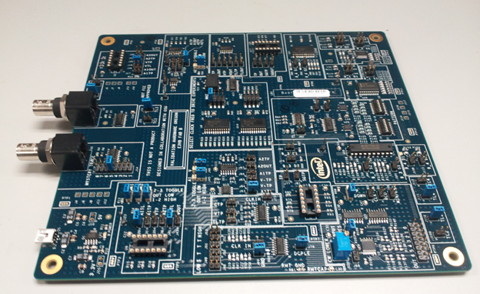
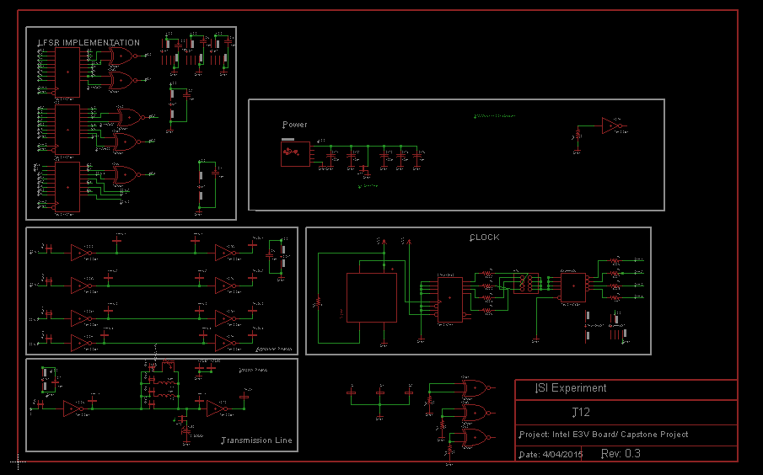
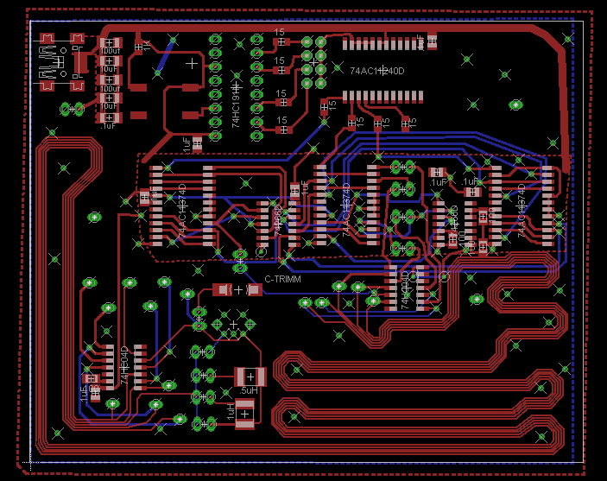
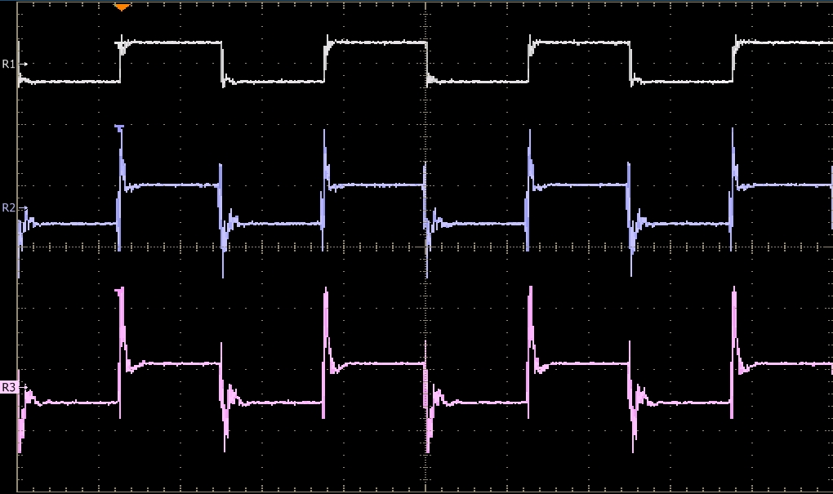

Signal Integrity Education
By: Travis Berger and Luis Santiago
Objective
E3VB
Proposed New Experiments
In order for students and industry members
to build an intuition for signal integrity issues
an educational board was developed to demonstrate
these issues on the bench. The Education Engagement
Electrical Validation Board E3VB helps bridge the gap
between theory learned in the classroom and
common problems that occur in a physical circuit. The
objective of this capstone project was to help improve
the E3VB by adding new experiments to the existing board.
Intersymbol Interference The goal of this experiment is to expand on the Intersymbol
Interference and the Crosstalk experiments.
This experiment uses four lines in parallel to show the effects of
aggressor lines on the signal integrity of the victim line. An LFSR is
used to create a random pattern generator.
Current Experiments:
Crosstalk
Decoupling
Corners and Vias
Mystery Traces
Simultaneous Switching Noise
LCR Transmission Lines
Driver Circuit Comparison
Package Differences
Intersymbol Interference
Oscilloscope pictures from
experiments
Mixed Signal Ground Technique The goal of this experiment is to highlight signal integrity issues that occur with improper grounding when a board contains both analog and digital circuity.
Oscilloscope pictures from new experiments or layout
Department of Electrical and Computer Engineering

